Slide 1

Predicting Flight Delays
By: Fucheng Yao, Limei Huang, Eman Nagib, Kwangwoo Kim, Huaiping Wang

Slide 2
Background

Slide 3
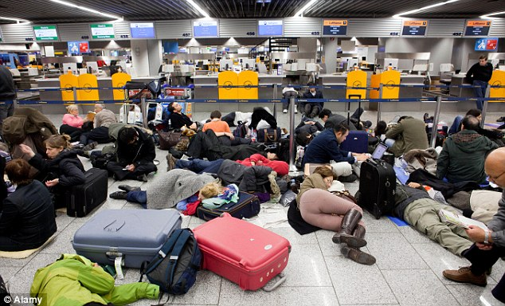
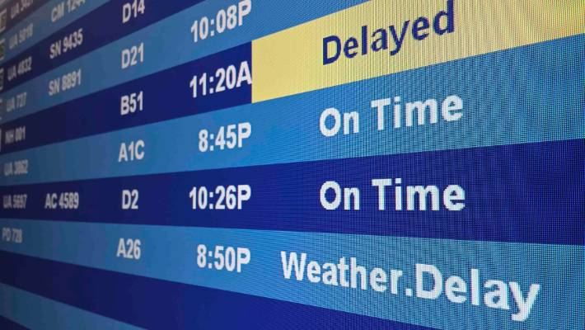
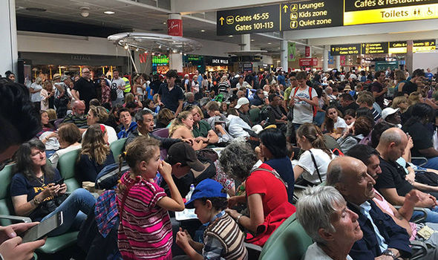
20% of flights in the U.S were significantly delayed in 2019

Slide 4










Main U.S. Airlines

Slide 5
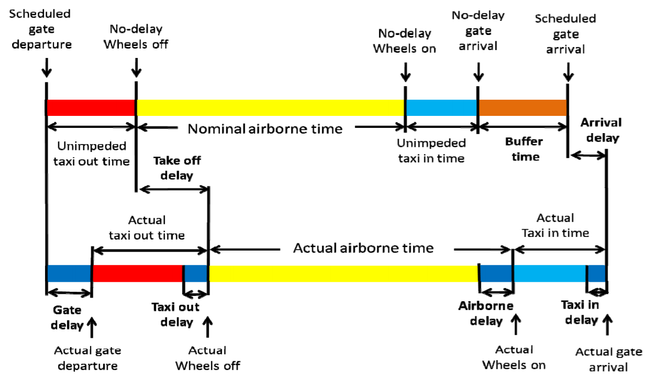
http://web.mit.edu/airlines/industry_outreach/board_meeting_presentation_files/meeting-nov-2010/Skaltsas%20Schedules%20and%20Delays.pdf
Understanding the Measurement of Delay

Slide 6
Data Background
Data Sources:
Flights data - Bureau of Transportation
Weather - National Weather Service (NOAA.gov)
Data Variables:
Data date range: 2015-2019
Includes 473 distinct U.S. airports
Includes 7 national holidays:President Day - Easter - Memorial Day - Independence Day, Labor Day, Thanksgiving, and Winter Holiday
Departure delay data: 177,526 rows and 382 columns
Arrival delay data: 177,526 rows and 384 columns
Notes:
Data Trends:
Avg. annual delays have been consistently on the rise since 2015-2019
Winter holiday has the highest avg. departure delays among other national holidays
Flights data are merged with weather data based on flights dates and airport code.
~50% of flights delays are due to late aircraft arrival

Slide 7
Challenges & Resolution

Slide 8

Challenges
Technical Challenges:
Non-technical Challenges:
Large dataset merging (over 9M records) :
Required cloud computing
Upgraded VM instance CPU and memory
5000 rows per month per year
Slow machine learning models
Data cleaning:
Dealing with outliers
Preparing tables for machine learning
Virtual collaboration:
Github and slack - to share code/ troubleshoot
Zoom for remote meetings
Ensure virtual meetings are efficient:
Meet for 45 mins at a time
Assign tasks before meeting
During meeting: share results and plan next steps
Collective decisions are made to move on - everyone on the same page

Slide 9
Project Scope Challenges
Constant reshaping and refining project goal:
Initial plan: Indicate areas were an airline can improve upon by showing how it compares to other airlines within the industry
Issue: Limited data to perform such analysis and derive meaningful insights
Next plan: Build a dashboard to rank airlines based mainly on delay estimates for a specific route and date selected by customer to inform customer’s ticket purchase decision
Issue: Scope too broad and difficult to manage having to transition to virtual collaboration amidst the Covid-19 changes
Final plan, using historical data, identify which model best predicts future flight delays and in turn identify top indicators of departure and arrival delays.
Research, gather, and compile variables that can be used in predicting delays
Notes:
Additionally, I think it would make a good impression to include a short slide on your progress. Did you have to change the scope of your problem? Did you change or added to your dataset? And what were the reasons? These could show the amount of efforts you have put into this project. This is completely optional.

Slide 10
Descriptive Analysis

Slide 11
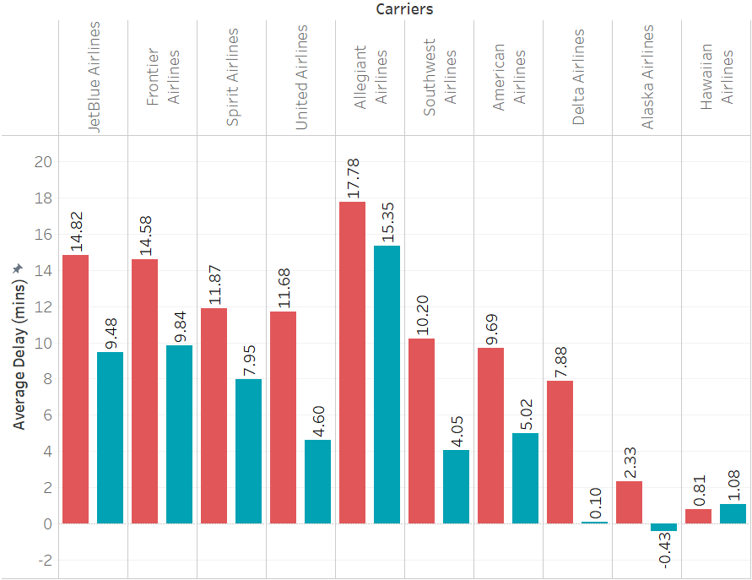




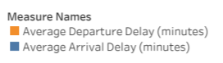
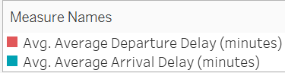
Arrival delays do not reflect departure delays
Airlines with highest departure delay rates:
Allegiant Airlines
Jet Blue Airlines
Frontier Airline
Airlines with Lowest departure delay rates:
Hawaiian Airlines
Alaska Airlines
Delta Airlines
Notes:
Dep - arr = big number (GOOD)
Dep - arr = small number (BAD)
10 - 2 = 8 GOOD
10 - 6 = 4 BAD
6 - 8 = -2 BAD

Slide 12
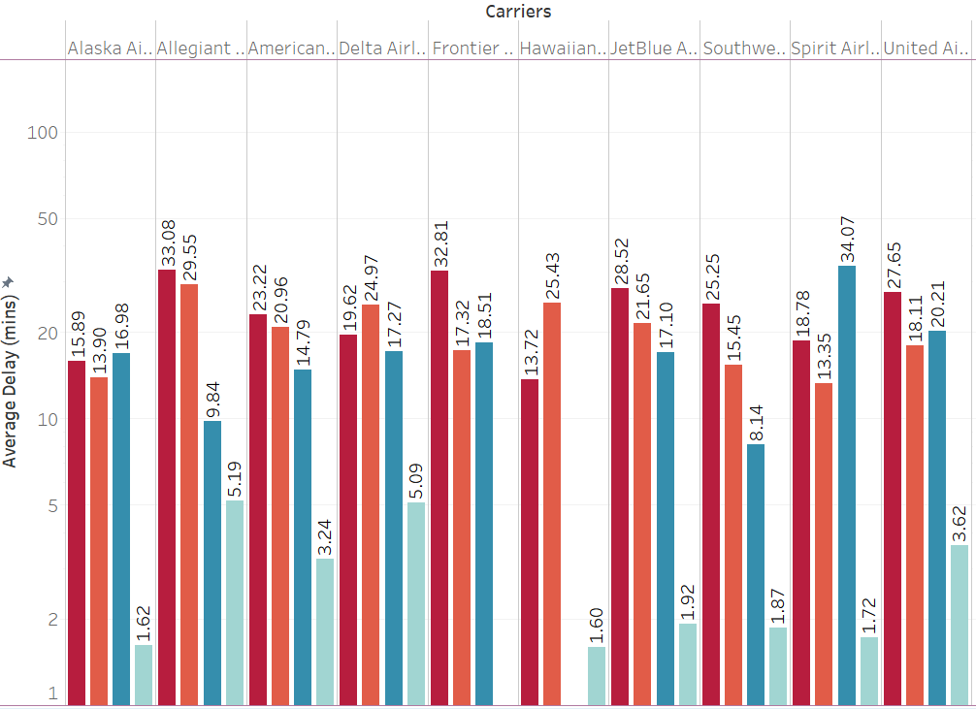
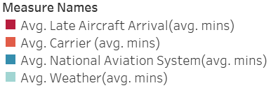
Major Delay Reason: Late Aircraft Arrival
Delay reasons ranking:
Late Aircraft Arrival
Carrier
National Aviation System
Weather
*security delays not included since they are typically <5 min on avg

Slide 13
Methods

Slide 14
Methodology
Simple model using all variables - find influential variables
Linear Regression
Forward selection
LASSO
Flexible models using all variables - identify best predictive model
*Parameters were adjusted using cross-validation
Random Forest
Boosting
XGBooost
Simple model using different combinations of variables
delay ~ origins
delay ~ destinations
delay ~ weather
delay ~ time

Slide 15
Methods - Tested 6 Machine Learning Models
Model | RMSE Test (departure delay) | RMSE Test (arrival delay)
Linear Regression | 26.27 | 14.60
Lasso Regression | 25.64 | 14.45
Forward Selection | 25.73 | 14.63
Boosting Trees | 25.96 | 15.42
Random Forest | 26.12 | 13.78
XGBoost | 25.38 | 13.86

Slide 16
Identifying Most Influential Variables
Weather: (-) Visibility, (+) Thunder, (+) Wind_speed
Months: (+) May, (+) June, (+) July, (+) August (summer months)
Day of week: (+) Monday, (+) Thursday, (+) Friday (end/beginning of week)
Origin/Destination: (+) JFK, (+) SFO, (+) EWR, (+) LGA
Airlines: (+) Frontier, (+) Jet Blue, (+) South West
Holidays: (+) Winter Holiday, (+) Thanksgiving
* + :positive correlation between the variable and the flight delays
* — :negative correlation between the variable and the flight delays

Slide 17
Limitations & Conclusion

Slide 18
Results Limitations and Criticism
01
Include More Informative Variables:
National aviation system
Flight scheduling
Late arrival
Airport congestion data
Flight schedules
Add Interactions among Variables
High RMSE and Low R Square
Departure RMSE: 25 minutes
R square around 7%
Variables limited to weather,
holiday, and route
Too many dummy variable
02
Constantly Update Real-Time Data
Constantly Update and Validate Model
Historical Data
Represent historical trends and seasonality
Things change quickly
Notes:
Historical data help spot trends & patterns likely to influence future course of actions.
However, predictive analysis should not be mistaken for prescriptive analysis especially in contexts were historical data are not necessarily accurate predictors of a constant-changing world.
Next: enhance accuracy of predicted delays based on:
Additional factors including social abnormalities, such as COVID-19, and
Real-time data can prove invaluable for further research.

Slide 19
Future Direction - End Product
Airline: *optional
Estimate Departure Delay:
Enter airline name
hh:mm
Flight Number:
Estimate Arrival Delay:
Enter flight number
Flight Date:
hh:mm
mm/dd/yy
Origin:
Enter origin airport
Destination :
Enter destination airport
Notify me - sign up for automatic updates:
Email or phone number
Notes:
Although some causes of delay such as extreme weather conditions are unavoidable,the two major causes can actually be addressed such as later aircraft arrival and carrier complications by using airport congestion data and flights schedules
By doing so you can address unnecessary airport congestion and as a result, enhance the customer experience.

Slide 20
Sources:
http://web.mit.edu/airlines/industry_outreach/board_meeting_presentation_files/meeting-nov-2010/Skaltsas%20Schedules%20and%20Delays.pdf
https://www.consumerreports.org/video-conferencing-services/how-to-prevent-zoombombing/
https://blog.masterofproject.com/sampling-methods/
https://www.vippng.com/preview/iRoRJim_data-icon-data-icon-png/
https://hotelchannelsmanager.com/blog/posts/Challenges-Facing-in-managing-Hotel-Booking-Channels
https://console.cloud.google.com/marketplace/details/noaa-public/gsod?project=team5-888
https://stat-or.unc.edu/files/2018/09/Paper3_MSOM_2012_AirlineFlightDelays.pdf
https://www.bts.gov/topics/airlines-and-airports-0
Data sets source: https://www.bts.gov/topics/airlines-and-airports-0
Weather data source: https://www.ncdc.noaa.gov/cdo-web/datatools/records;
https://console.cloud.google.com/marketplace/details/noaa-public/gsod?project=team5-888

Slide 21
Appendix
Departure Delay EDA
Holiday Statistics EDA
Major Delay Reason EDA
Major Delay Reason Explanation
Data Preparation
Data Variables
Data Cleaning - Departure
Data Cleaning - Arrival
Delay Rate Rankings 2019
Random Forest Departure Variable Importance
Random Forest Arrival Variable Importance
Boosting Departure
Boosting Arrival
Xgboost Departure
Xgboost Arrival

Slide 22
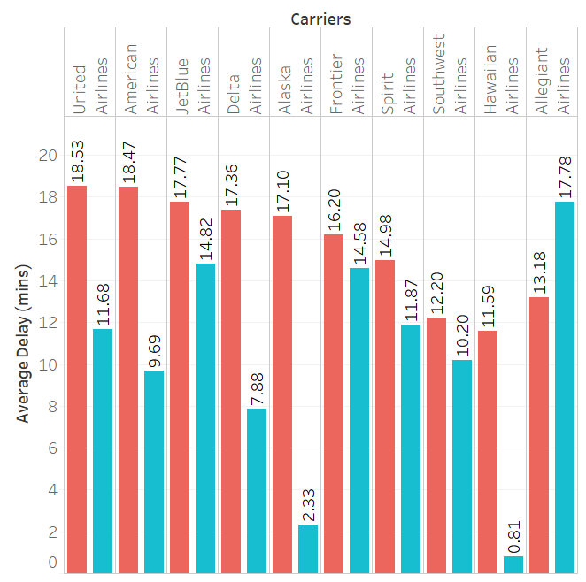
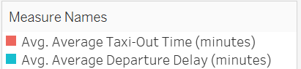
Departure delays + taxi-Out delays
Return to Appendix
Airlines with highest departure delay rates:
Allegiant Airlines
Jet Blue Airlines
Frontier Airline
Airlines with Lowest departure delay rates:
Hawaiian Airlines
Alaska Airlines
Delta Airlines
Notes:
Fix ranking
Add logos instead of names

Slide 23
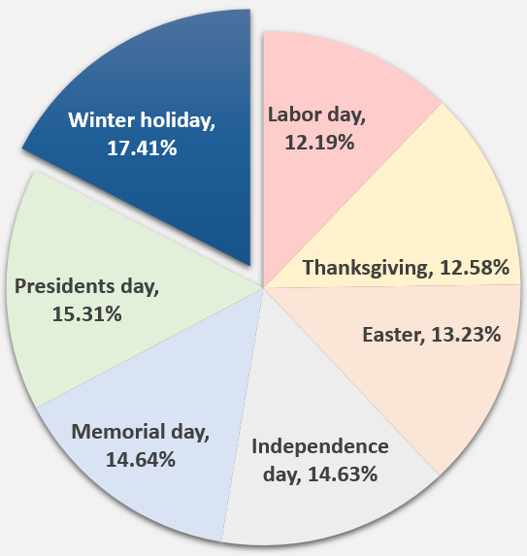
Holiday Delay Statistics:
Return to Appendix

Slide 24
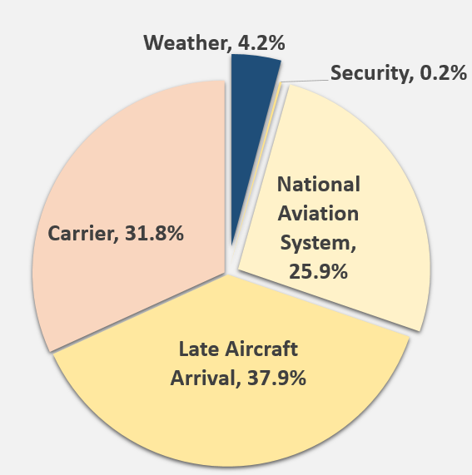
Major Flight Delay Reason
Return to Appendix

Slide 25
Causes of Delay Explained
Return to Appendix
• Air Carrier Delay: The cause of the cancellation or delay was due to circumstances within the airline’s control (e.g. maintenance or crew problems, etc.).
• Extreme Weather Delay: Significant meteorological conditions (actual or forecasted) that, in the judgment of the carrier, delays or prevents the operation of a flight.
• National Aviation System Delay: Delays and cancellations attributable to the national aviation system refer to a broad set of conditions -- non-extreme weather conditions, airport operations, heavy
traffic volume, air traffic control, etc.
• Security Delay: Delays caused by evacuation of terminal or concourse, re-boarding of aircraft because of security breach, inoperative screening equipment and long lines in excess of 29 minutes
at screening areas.
• Late Arriving Aircraft Delay: Previous flight with same aircraft arrived late caused present flight to depart late

Slide 26
Data Preparation
Return to Appendix
Flight Delays
Weather
Cleaning
Airport ID
Year & month & day
Delays: departure
arrival
Station ID (stn)
Airport
Year & month & day
State
Temperature
Visibility
Wind speed
Fog
Rain
Snow
Thunder
Remove NAs
Replace Outliers
Create New Variables
Total arrival delay
Total departure delay
Dummy Variables

Slide 27
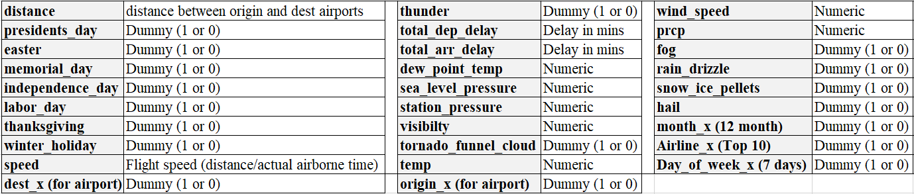
Data Variables
Return to Appendix

Slide 28
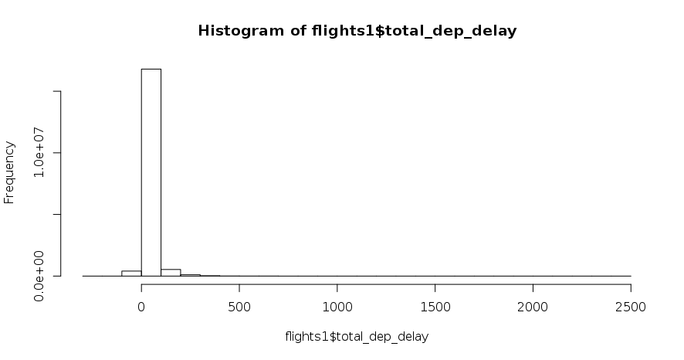
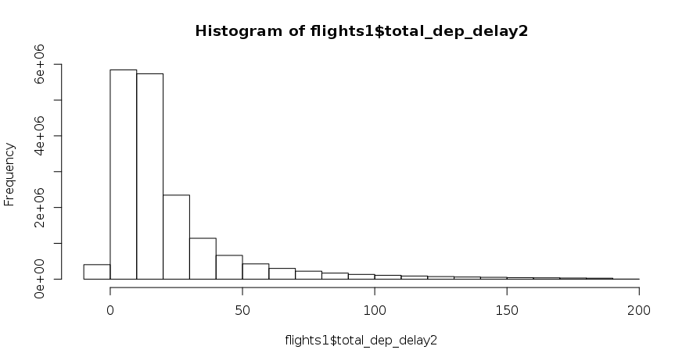
Dealing with departure delay extreme values
Return to Appendix
Before dealing with extreme values
After dealing with extreme values

Slide 29
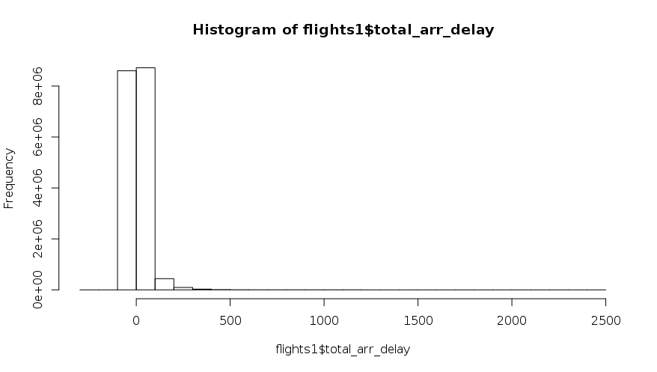
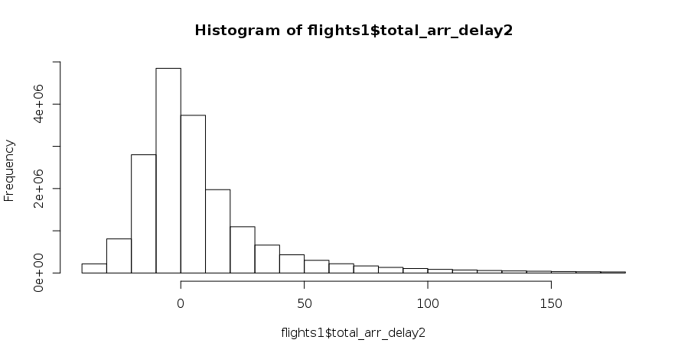
Dealing with arrival delay extreme values
Return to Appendix
Before dealing with extreme values
After dealing with extreme values

Slide 30
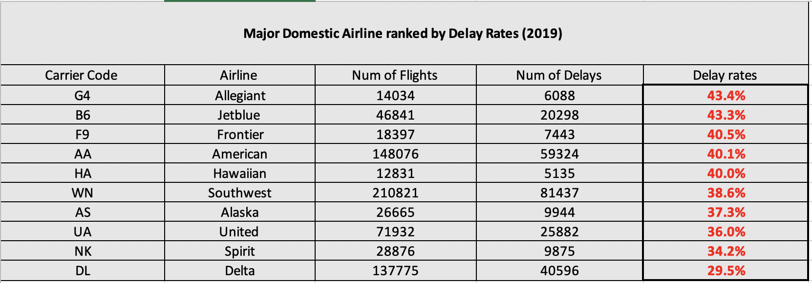
Delay - Rankings
Return to Appendix
For major domestic airlines, Allegiant has the highest delay rates.
Delta airline has the lowest delay rates among the major domestic airlines in 2019.

Slide 31
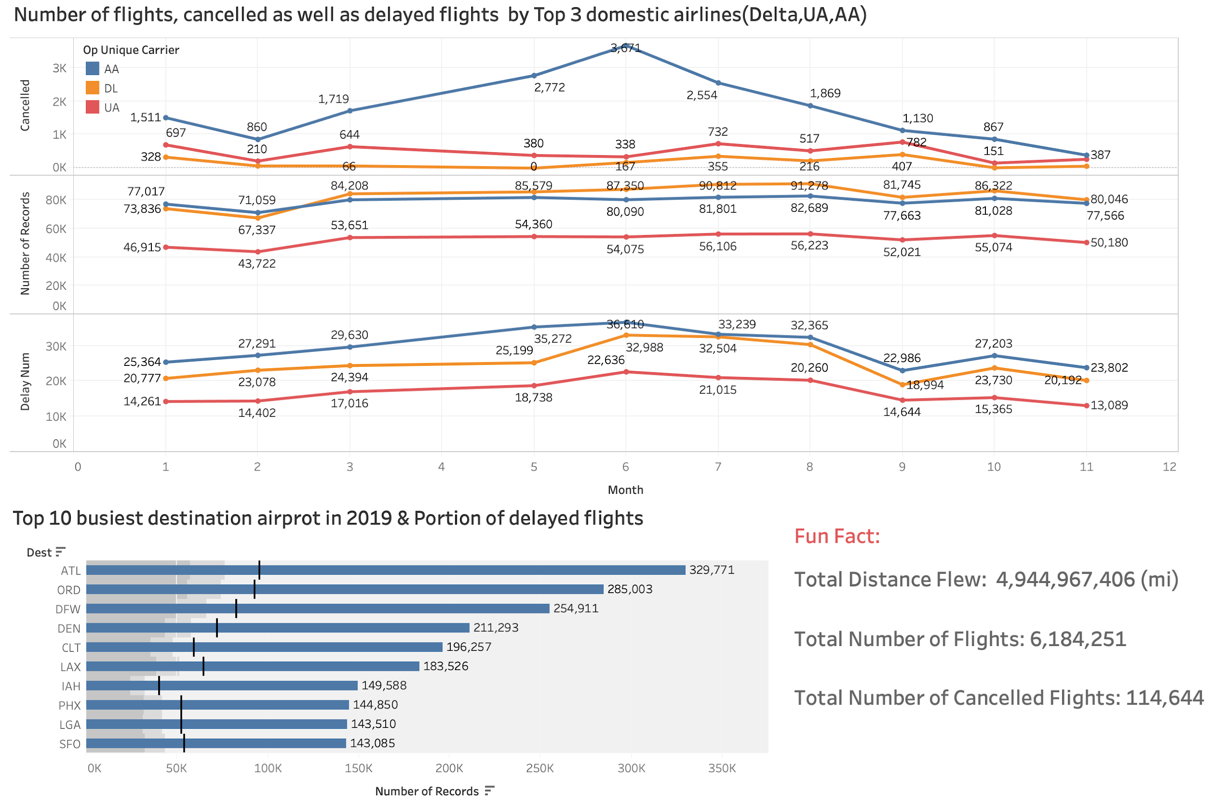
Delay - General
Return to Appendix
In 2019, the number of delays for the top 3 domestic airlines increase as time goes by and then falls down in September.
For the top 10 busiest airports in 2019, delay rates were at least 15% of the flights for all the airports.

Slide 32
Linear Regression Departure Delay (RMSE =26.27 )
Return to Appendix
Top 5 Positive Variables | Estimate
dest_GJT | 32.46
dest_ABE | 16.81
origin_JFK | 15.14
origin_LGA | 14.89
dest_SFB | 13.05
Top 5 Negative Variables | Estimate
origin_ORH | -13.12
origin_LBB | -8.09
origin_BIL | -7.64
origin_FNT | -7.64
origin_ROC | -6.61

Slide 33
Linear Regression Arrival Delay (RMSE = 14.60 )
Return to Appendix
Top 5 Positive Variables | Estimate
dest_BQN | 11.34
origin_EYW | 9.14
dest_ORD | 7.34
dest_LAX | 7.15
dest_SJU | 7.13
Top 5 Negative Variables | Estimate
origin_LGA | -14.07
origin_JFK | -12.65
origin_CHA | -12.24
origin_ILM | -11.78
origin_TYS | -7.80

Slide 34
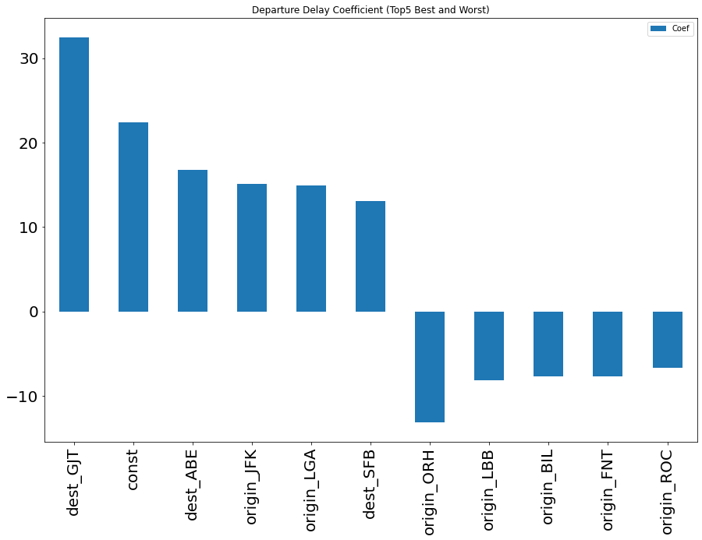
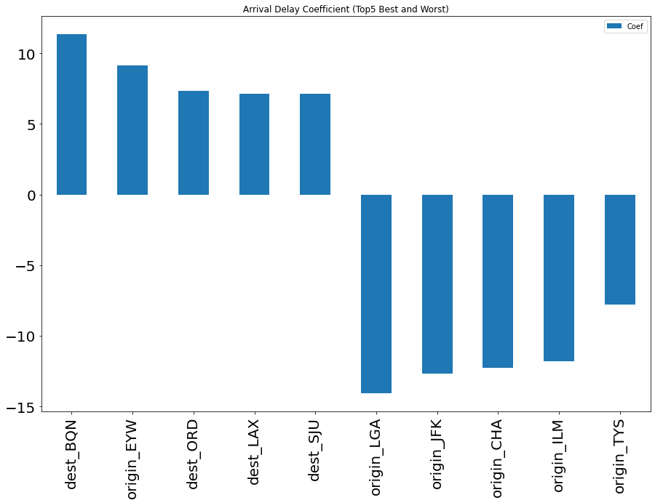
Variable Selection - Linear Regression (top 5 and tail 5)
Return to Appendix
Variable coefficients for departure delay
Variable coefficients for arrival delay

Slide 35
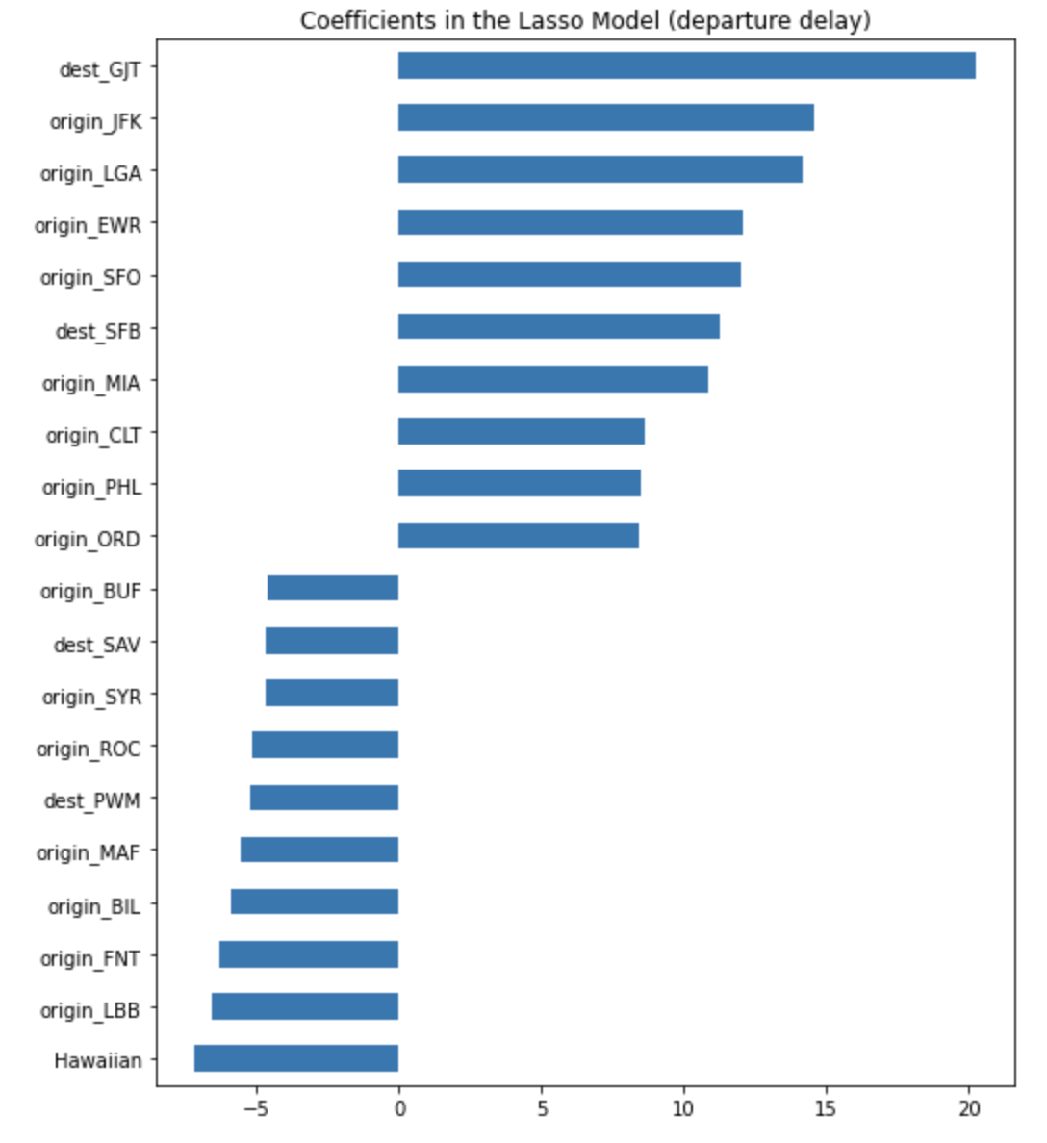
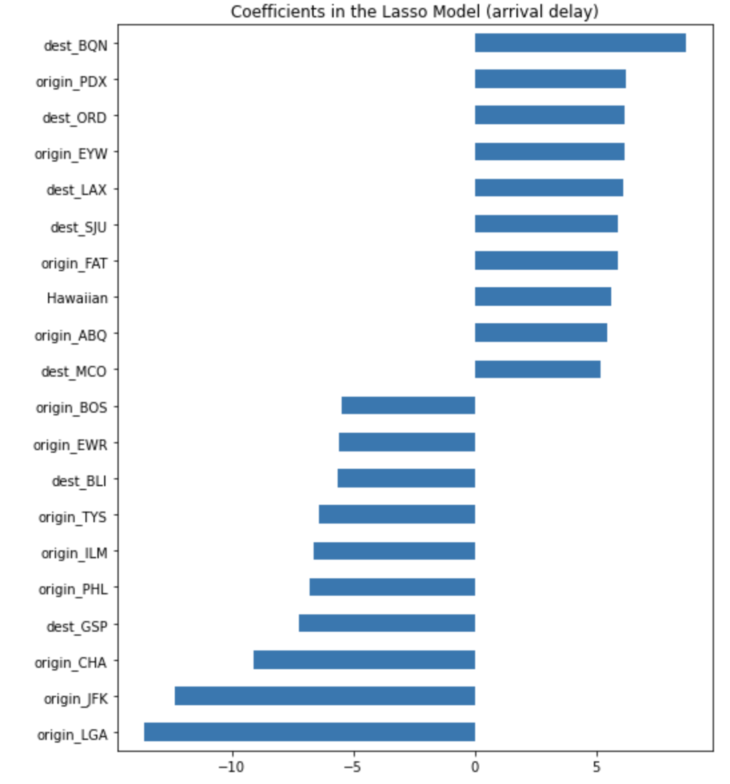
Variable Selection - Lasso (top 10 and tail 10)
Return to Appendix
Variable coefficients for departure delay
Variable coefficients for arrival delay

Slide 36
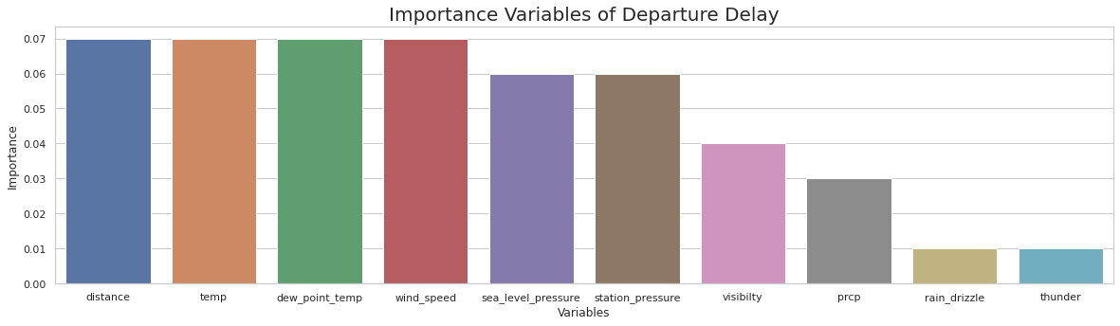
Random Forest Departure Delay (RMSE = 26.12)
Return to Appendix

Slide 37
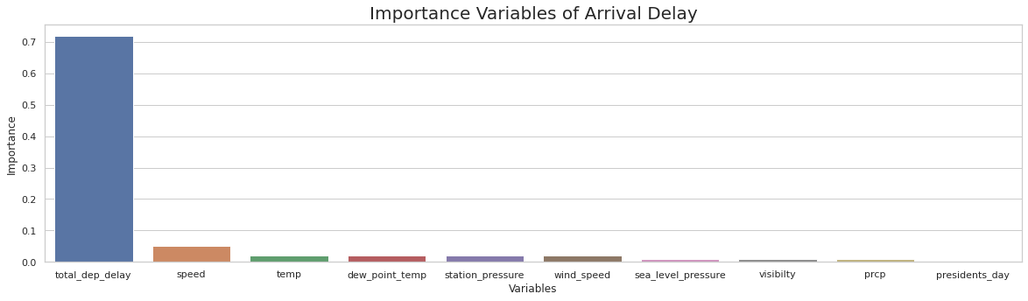
Random Forest Arrival Delay (RMSE = 13.78)
Return to Appendix

Slide 38
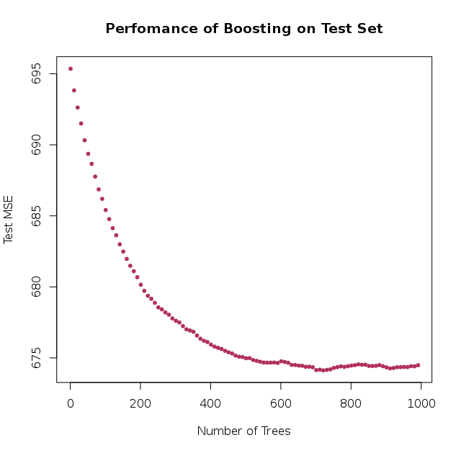
Boosting Departure Delay (RMSE = 25.96 )
Return to Appendix
Variables | Estimates
wind_speed | 3163750
temp | 2571919
visibilty | 2090275
dew_point_temp | 1674257
distance | 1627293
station_pressure | 1259597
United | 1051703
prcp | 969918.7
sea_level_pressure | 923527.9
thunder | 713101.6

Slide 39
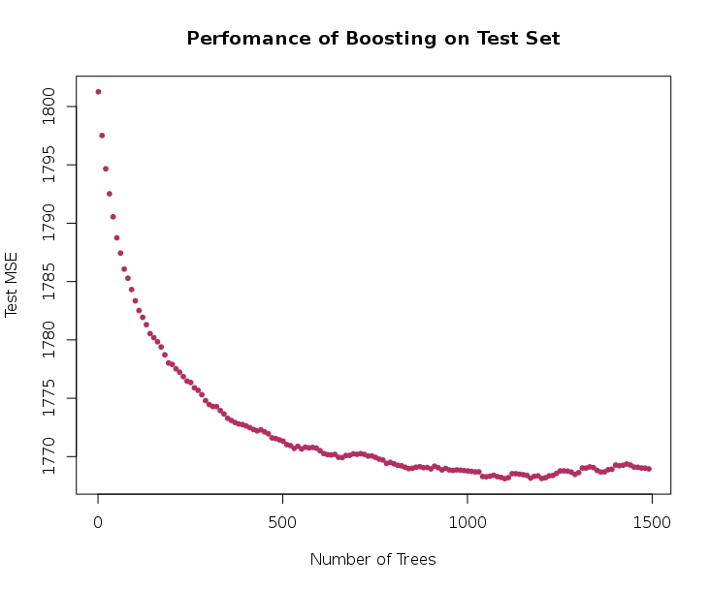
Boosting Arrival Delay (RMSE = 15.42)
Return to Appendix
Variables | Estimates
total_dep_delay | 107910707
speed | 3582212.05
Delta | 967443.024
temp | 613150.767
Spirit | 371423.605
station_pressure | 329526.498
United | 96601.225
wind_speed | 48014.023
dew_point_temp | 33174.519
sea_level_pressure | 29467.37

Slide 40
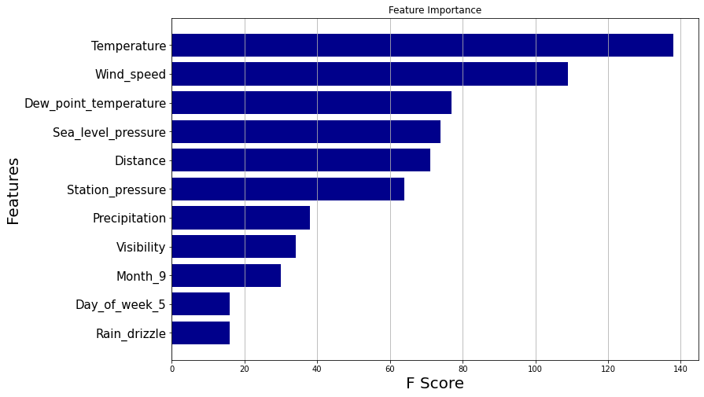
XGBoost Departure Delay (RMSE = 25.38)
Return to Appendix

Slide 41
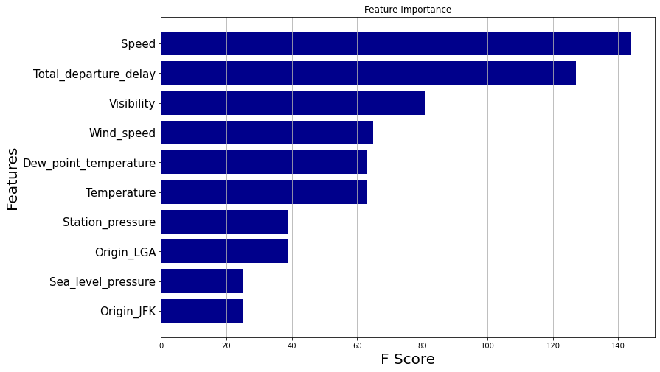
XGBoost Arrival Delay (RMSE = 13.86)
Return to Appendix

